Slide 1
BT201
Biochemical Process Calculations
15/09/2022

Slide 2
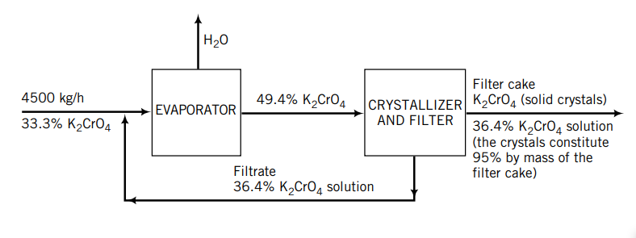
Recycle without Reaction: Recycle of material occurs in a variety of processes that do not involve chemical reaction, including distillation, crystallization, and heating and refrigeration systems.

Slide 3
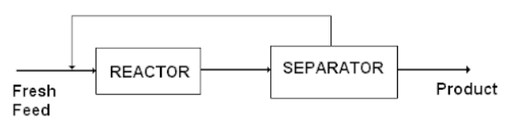

Process with recycle
Recycle Material (or energy) that leaves a process unit that is downstream and is returned to the same unit or an upstream unit for processing again.
Recycle in a Process with a Reaction Occurring
It is rare that a chemical reaction A → B proceeds to completion in a reactor. No matter how little A is present in the feed or how long the reaction mixture remains in the reactor, some A is normally found in the product. Any A that leaves with the product therefore represents wasted resources. separate most or all of the unconsumed reactant from the product stream resulting relatively pure product and the unconsumed reactant A back to the reactor.
A: 90,
B: 30
Recycle
A: 10,
B: 100
A: 100,
B: 130
A: 200,
B: 30
A: 110 kg/min

Slide 4
Process with recycle to recover crystalline potassium chromate
Forty-five hundred kilograms per hour of a solution that is one-third K₂CrO₄ by mass is joined by a recycle stream containing 36.4% K₂CrO₄, and the combined stream is fed into an evaporator. The concentrated stream leaving the evaporator contains 49.4% K₂CrO₄ ; this stream is fed into a crystallizer in which it is cooled (causing crystals of K₂CrO₄ to come out of solution) and then filtered. The filter cake consists of K₂CrO₄ crystals and a solution that contains 36.4% K₂CrO₄ by mass; the crystals account for 95% of the total mass of the filter cake. The solution that passes through the filter, also 36.4% K₂CrO₄, is the recycle stream.
Calculate the rate of evaporation, the rate of production of crystalline K₂CrO₄, the feed rates that the evaporator and the crystallizer must be designed to handle, and the (mass of recycle)/(mass of fresh feed).
Suppose that the filtrate were discarded instead of being recycled. Calculate the production rate of crystals.
What are the benefits and costs of the recycling?

Slide 5
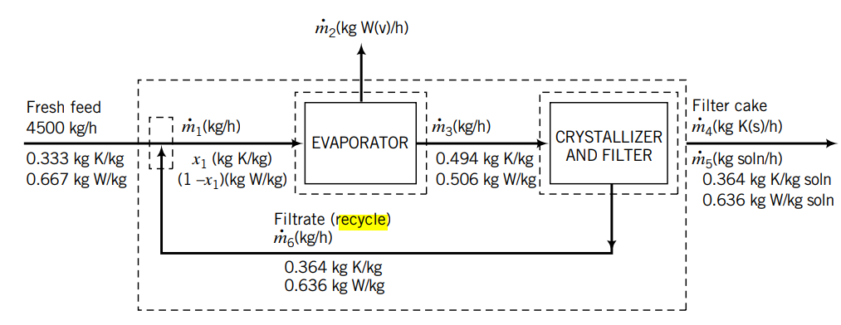
The flowchart of a steady-state process to recover crystalline potassium chromate (K2CrO4 ) from an aqueous solution of this salt

Slide 6
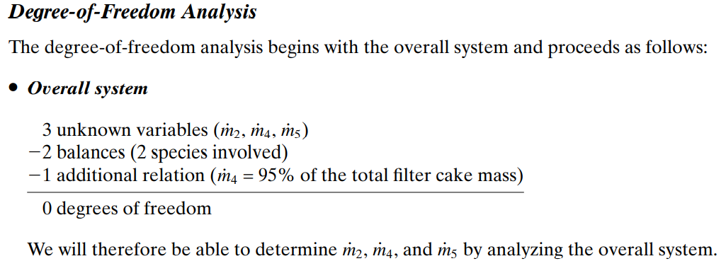

Slide 7
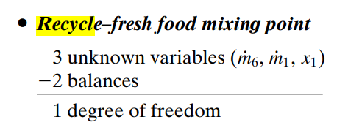
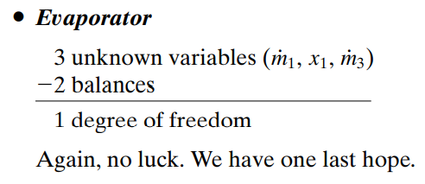
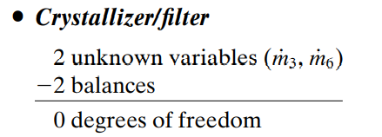

Slide 8
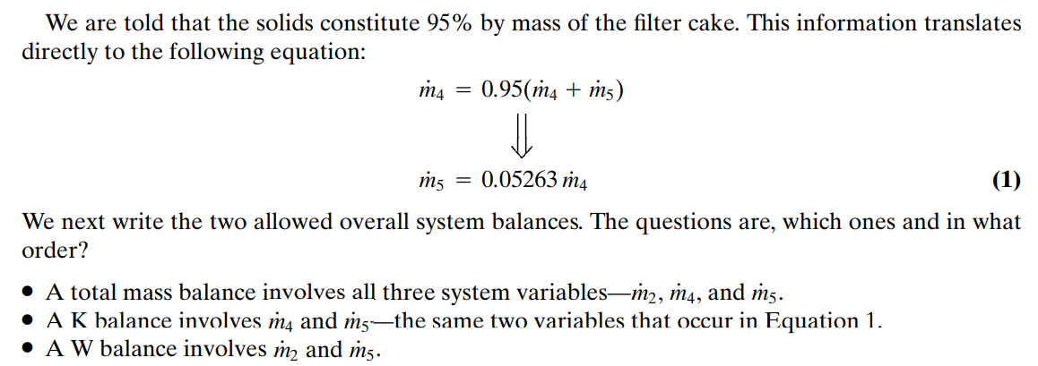

Slide 9

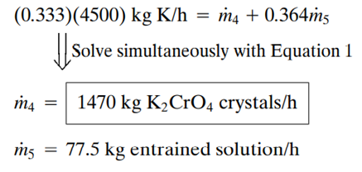

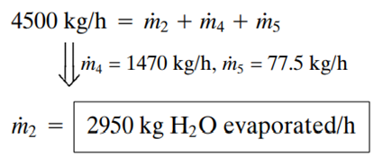

Slide 10
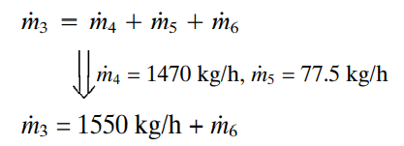

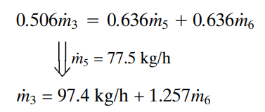
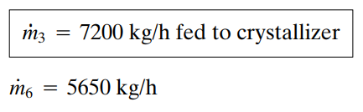
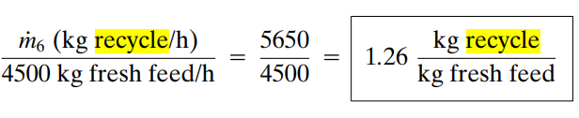

Slide 11
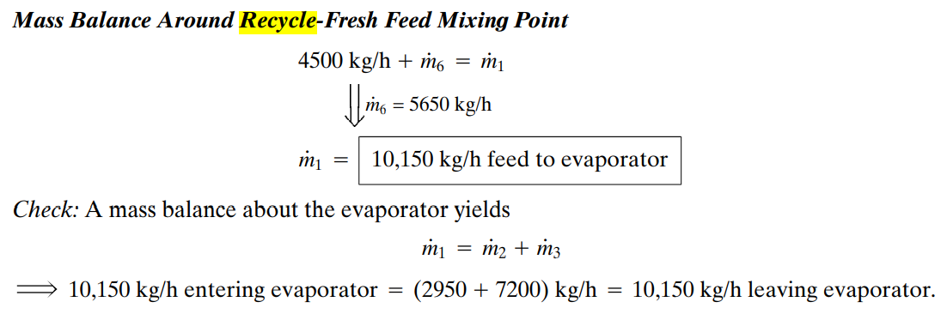

Slide 12
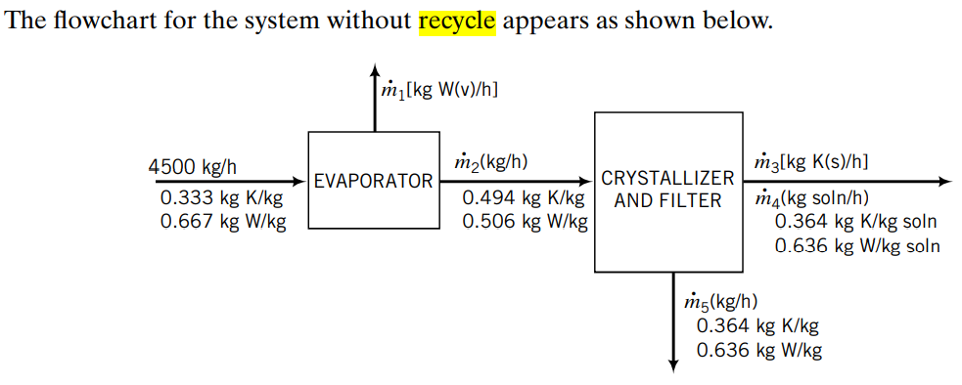
The degree-of-freedom analysis leads to the results that the overall system has one degree of freedom, the evaporator has zero, and the crystallizer–filter has one.
The strategy is therefore to begin with the evaporator and solve the balance equations. Once stream flowrate is known, the crystallizer has zero degrees of freedom and its three equations may be solved.

Slide 13

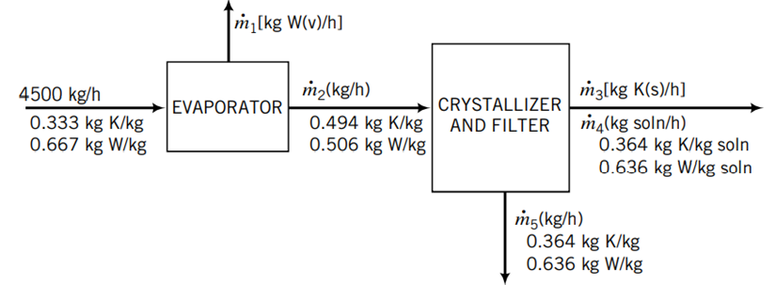

The rate of production of crystals is
With recycle it was 1470 kg/h, a dramatic difference.
The mass flow rate of the discarded filtrate
The filtrate (which is discarded) contains 0.364 x 2380 = 866 kg/h of potassium chromate, more than the filter cake contains. Recycling the filtrate enables us to recover most of this salt. The obvious benefit of recycling is the revenue from selling the additional potassium chromate. The costs include the purchase and installation costs for the recycle piping and pump and the cost of power consumed by the pump. It would probably not take long for the benefit to equal the cost, and thereafter the recycling would continue to increase the process profitability.

Slide 14
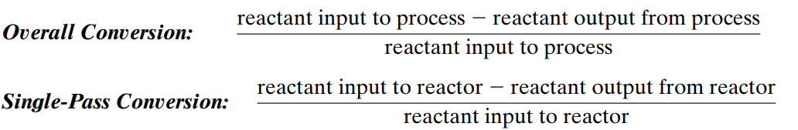

Recycle with reaction
Two definitions of reactant conversion are used in the analysis of chemical reactors with product separation and recycle of unconsumed reactants:
Recycle

Slide 15
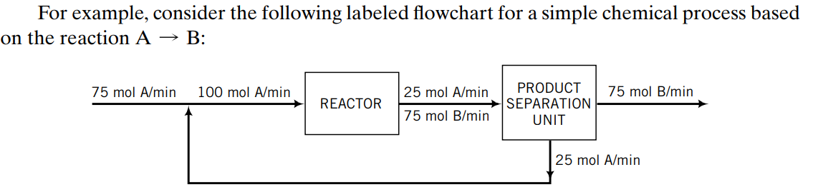


The overall conversion of A
The single-pass conversion

Slide 16
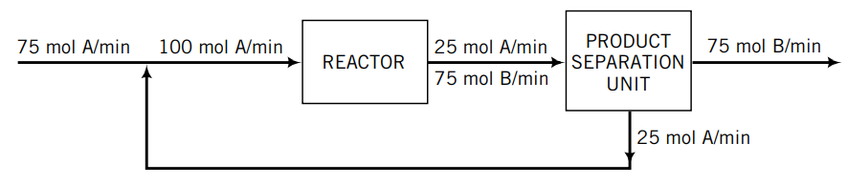
This example provides another illustration of the object of recycle. We have achieved complete use of the reactant for which we are paying—the fresh feed—even though only 75% of the reactant entering the reactor is consumed before emerging.
The reason the overall conversion is 100% is that perfect separation was assumed: any A that does not react gets sent back to the reactor.
If a less-than-perfect separation were achieved and some A left with the product stream, the overall conversion would be less than 100%, although it would always be greater than the single-pass conversion

